Slide 1
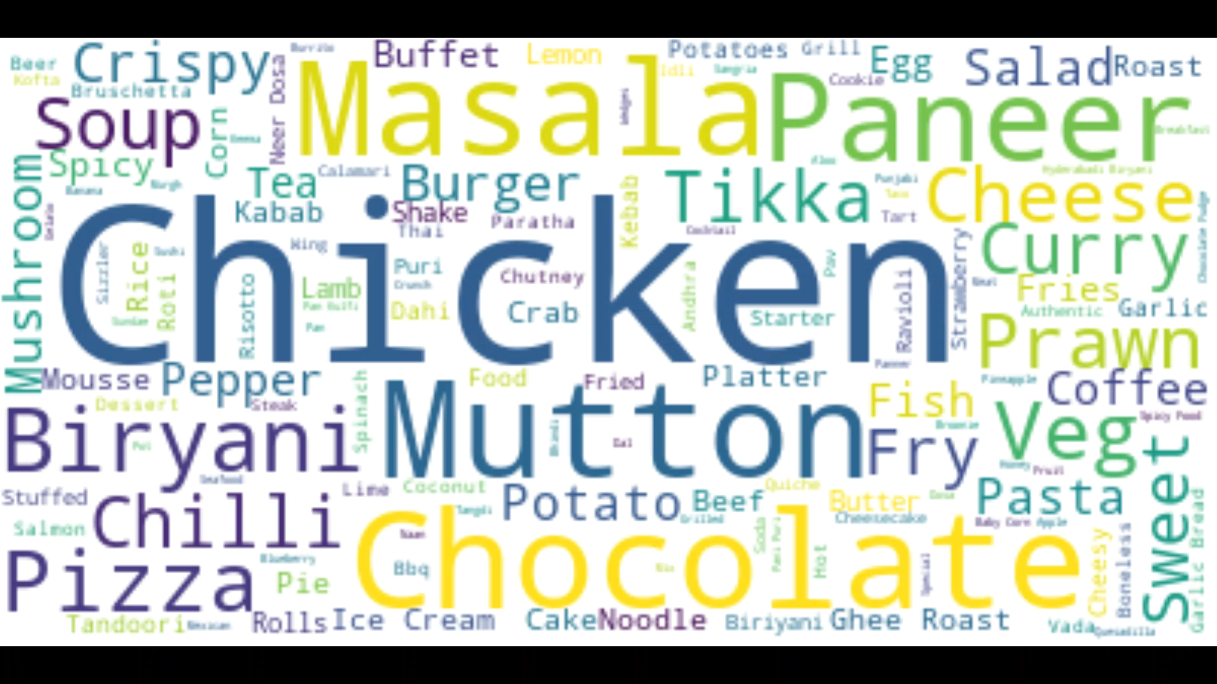

Slide 2
Analyzing and Predicting Features to Increase the user base for Zomato App
Group – 5 Aditi Tibrewal, ID: 1001955627 Faria Tasnim, ID: 1002036395 Vishali Bairam, ID: 1001967007 Sai Goutham Chiriki, ID: 1002018678

Slide 3
Business Context and Goal Analysis
Zomato is an Indian multinational restaurant aggregator and food delivery company. Their business model is based on providing local restaurants search services and collecting data on food menus, contacts and providing relevant information to their customers on the mobile app and its online website. Zomato earns their revenue in two folded way- one is through commission for every delivery from a restaurant and second one is through delivery fee. Thus, user preferences and selection of choices assumes a vital part in deciding the development of the app which leads to increasing user base to the platform welcoming more revenues for Zomato.
For this group project, we are committed to analyze the data collected by Zomato through their mobile app of different user preferences compared to dinner and delivery ratings and reviews and average cost per restaurant.
Selecting the most significant features/options that have strong relationship with the average cost.
Based on our research and data analysis, we want to propose a best model for predicting average cost to attract new user base for the app.

Slide 4
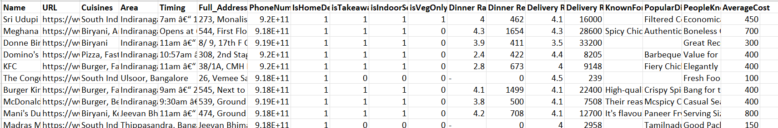
Raw Data
Zomato Bangalore data set.
In total 19 columns and 8924 rows.
There are 4 binary columns, 4 discrete columns, 2 continuous column and 9 categorical columns in the dataset.
Data set contains dinner and delivery ratings and reviews, number of cuisines served and average cost.
7 out of 19 columns are in text and 4 of these 7 columns(KnownFor,PopularDishes, PeopleKnownFor) had more than 3000 rows of missing values, was removed from analysis.
Found 5324 cells in Dinner ratings and 1131 cells in Delivery ratings having (-) values which were replaced by the mean ratings.
Though Data has many columns, Categorical and Quantitative data which we use in analysis are countable on fingers.

Slide 5
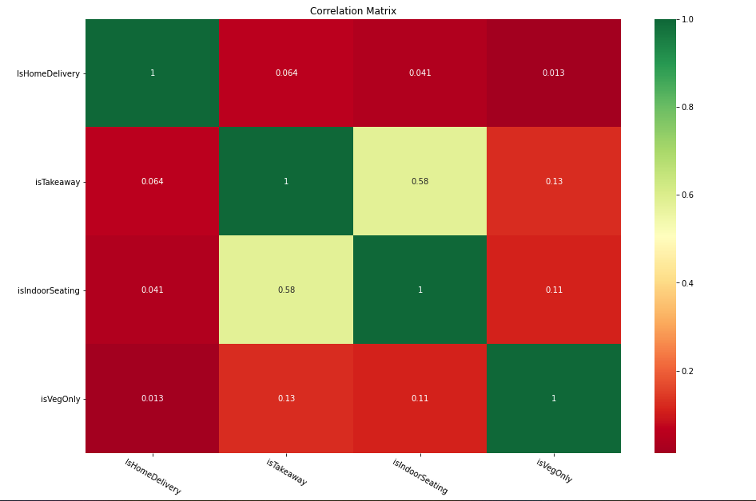
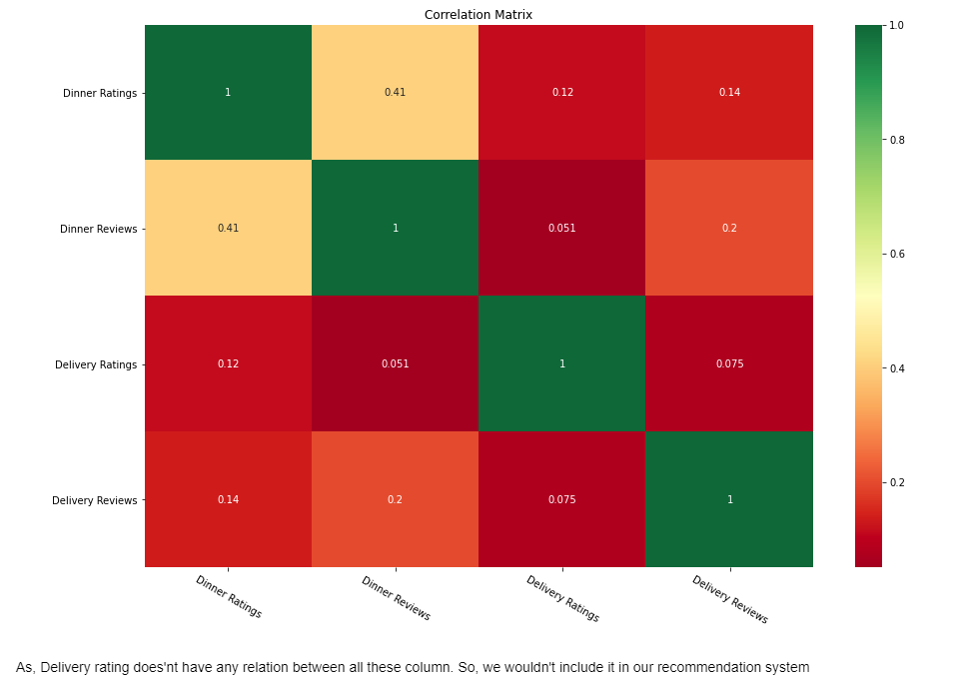
Data Visualization
Correlation matrix between isHomeDelivery, isTakeaway, isIndoorSeating, isVegOnly.
Correlation matrix between Dinner Ratings, Dinner Reviews, Delivery Ratings and Delivery Reviews.

Slide 6
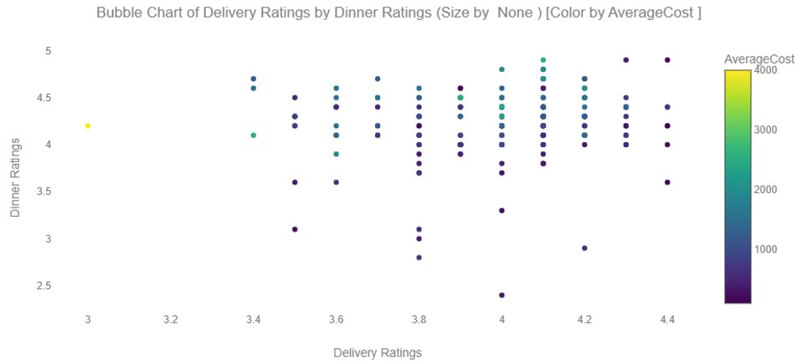
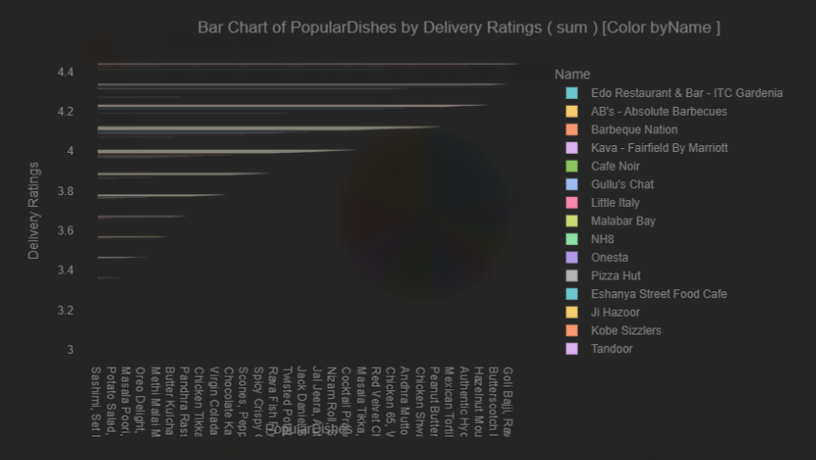
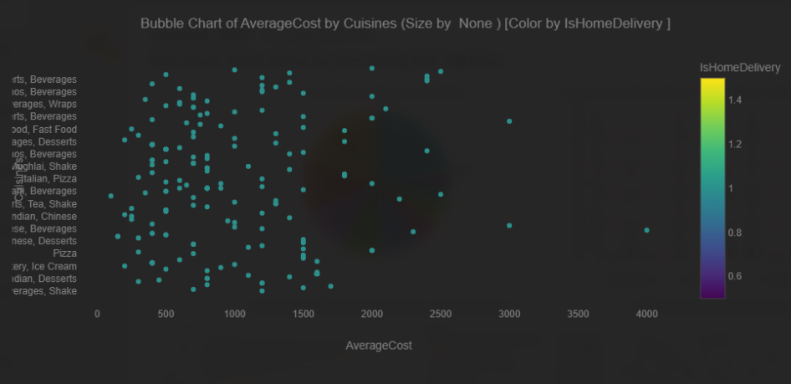
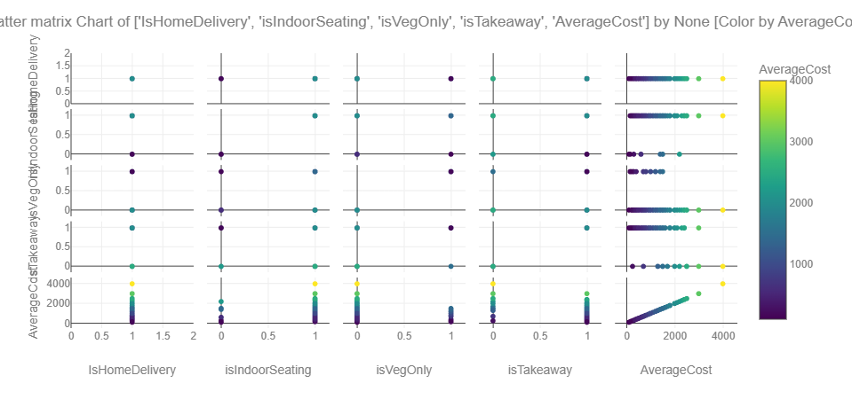
Data Visualization

Slide 7
Data Preparation and Model Selection
Data Visualization: we have used correlation matrix between dinner and delivery ratings and reviews and to understand relationships between IsHomeDelivery, isTakeaway, isIndoorSeating and isVegOnly . We have also used bar chart for popular dishes by areas and bubble chart to explore average cost by different cuisines.
Multiple Linear Regression: to determine which variables are significant and to find the ultimate model.
Decision Trees: to evaluate the options available for user selection and find the accuracy of the model
Model Comparison: to determine the best model for recommendation
The data preparation consists of converting categorical data into quantitative data.
There were total 168 distinctive locations for which we created a new variable called area index.
We converted no of cuisines into numerical data by calculating and aggregating how many cuisines each restaurant is serving.
We have converted average cost into binary groups: if average cost is less than 1000 then it falls to 0 group, if average cost is greater than 1000 then it falls to group 1.
We have removed URL, timing, full address, telephone, known for, popular dishes and people known for columns from the data set as those were having the greatest number of missing values.

Slide 8
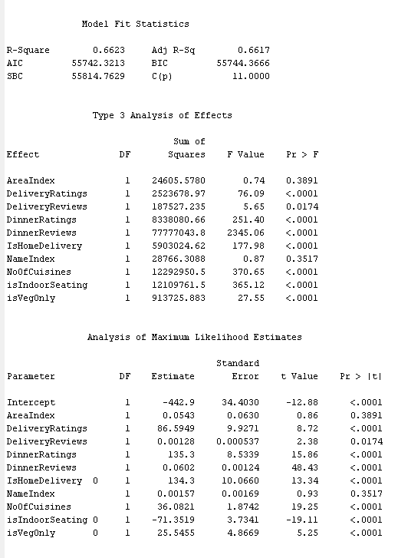
Multiple Regression
We ran multiple regressions to identify the best fit of model and to generate an equation in predicting average cost based on user’s selection of choices.
R-Square: 0.6623
Adj R-Square: 0.6617

Slide 9
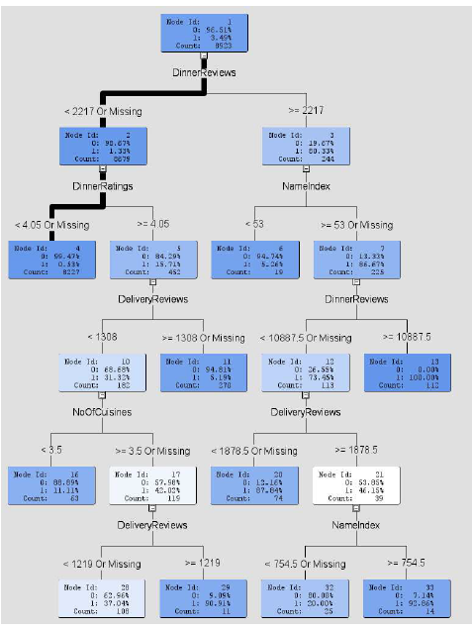
Decision Tree
For Decision tree model, we have considered all the variables except name, price range, isTakeaway, AverageCost.
If dinner reviews is < 2217 and dinner ratings is <4.05 then 99.47% data falls into the 0 group where average cost is less than 1000. The rule of decision tree is self explanatory as people are more prone to look for restaurant options that provides a good meal within an average cost of 1000 rupees on Zomato app.

Slide 10
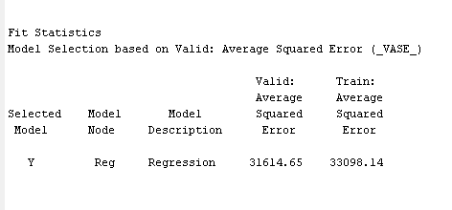
Conclusion
By applying above mentioned visualization and prediction technique we can estimate the significant variables which brings new user to Zomato app.
Through model comparison, we can conclude that multiple linear regression is the best model so far.
DeliveryRatings, DinnerRatings, Dinner Reviews, NoOfCuisines, IsIndoorSeating, IsVegOnly, IsHomeDelivery variables are significant in predicting average cost based on the data set.
Equation to attract new user base by predicting average cost:
Average cost = 86.5929* DeliveryRatings + 135.3*DinnerRatings + 0.0602*DinnerReviews + 36.0821*NoOfCuisines – 71.3519*IsIndoorSeating + 25.5455*IsVegOnly +134.3*IsHomeDelivery – 442.9

Slide 11
Thank You!

